Slide 1
KING COUNTY
HOUSING PRICE REGRESSION
WONG ZHAO WU

Slide 2
Introduction
The housing dataset contains home sales prices and characteristics for Seattle and King County, WA (May 2014 - 2015) and its corresponding shape file with the zip code zones for King County.
Additional geoJSON file which contains the shape of each zip code for King County was retrieved from King county GIS Open Data to facilitate EDA.
Modelling Objectives
KING COUNTY
Perform EDA and Modelling to find the optimal solution in estimating the housing prices by minimizing Root Mean Squared Error as the primary metrics.
REAL ESTATE

Slide 3

EDA SUMMARIES
EXTREME OUTLIERS
Extreme outliers are observed for several numerical columns.
DATA SKEWNESS
Data distribution is positively skewed for most numerical columns including price.
MISSING VALUES
Missing Values are observed for yr_renovated (95.7%), sqft_renovated (60.73%).
GEOLOCATION FEATURES
Certain region has higher housing price by visualising the colored map.
WEAK STATIONARY TIME SERIES
Housing Price just fluctuating against selling date.

Slide 4
DATA PREPROCESSING
Dropping Columns
Handling Missing Values
Log Transformation
Drop the columns that does not review any relationship with the target variable: Id, Date, Zipcode.
As there are more than around 95% and 60.73% of missing values from "yr_renovated", "sqft_basement", the safest approach is to drop both columns entirely.
We perform log transformation to unskewed the feature columns that are highly skewed with extreme outliers.

Slide 5
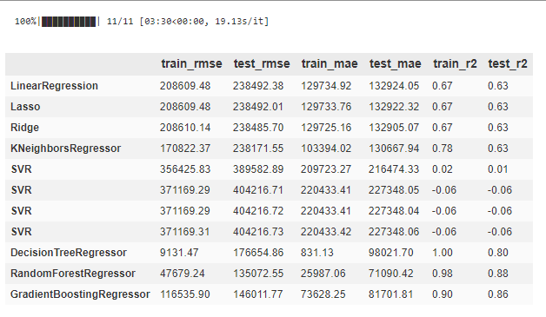
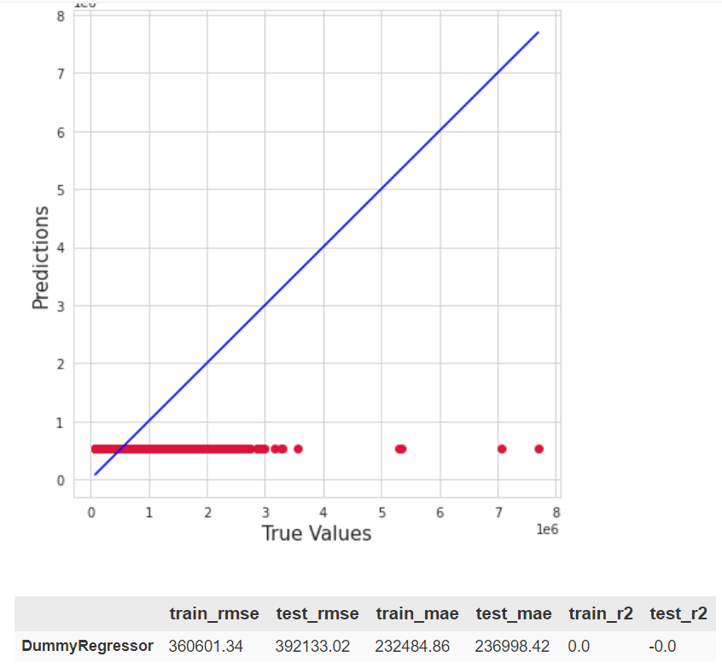
BASELINE MODELLING & MODEL SELECTION
Baseline DummyRegressor
Baseline Model Selection
Linear Models
Does not seems to suffers from major overfitting
Might be suffering from underfitting due to inductive biases.
KNeighborsRegressor
Suffer from major overfitting.
Might be suffering from slight underfitting.
SVMs (linear, rbf, poly, sigmoid)
Changing of Kernels does not seems to improve the performance of SVMs
SVMs suffers from high biases as the train and test set errors are relatively high
Conclusion
Tree-based models can produce promising results after reducing overfitting. Hence, further model tuning is required to reduce overfitting.
Linear models suffers from high biases. Hence, we can try to increase the model complexity to reduce overfitting.
We make use of dummy regressor as baseline model by always predicting the mean of target variable. The baseline predictor serves as reference point for model selection.
Decision Tree & Ensemble Models
Suffer as much overfitting
Low biases and able to obtain relatively lower testing error.

Slide 6
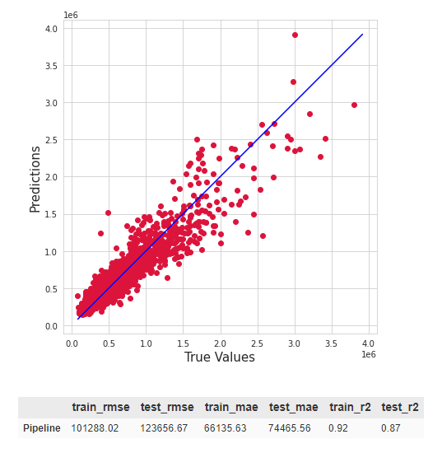
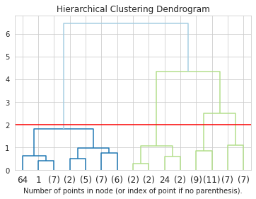
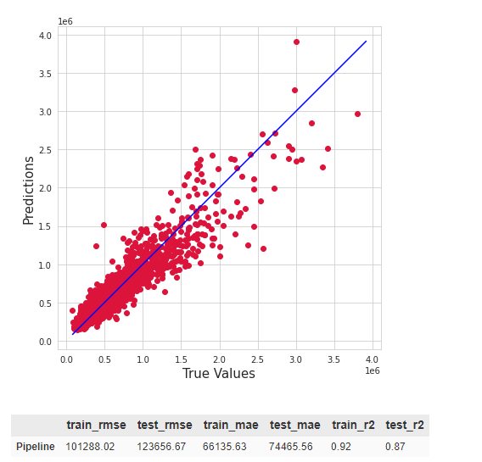

MODEL IMPROVEMENT
Hold-Out Dev Set
Geo-Spatial Data Feature Engineering
Preprocessing Pipeline
Perform hierarchical clustering based on common housing features grouped by zipcode.
Using pipeline to preprocess the data before parsing it into the final model.
Cleaned Dataset w Feature Engineering
Other Features
zipcode_cluster
Standard-Scaler
OneHot- Encoder
Polynomial-Features
Gradient-Boosting-Regressor
5-Fold CV
Hyperpa-rams Tuning!

Slide 7
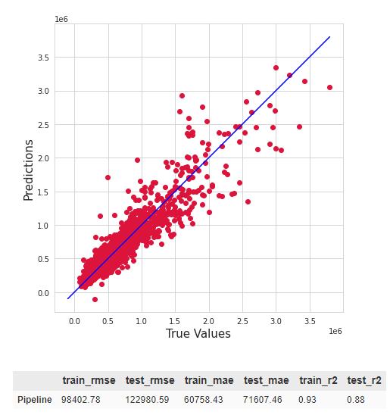
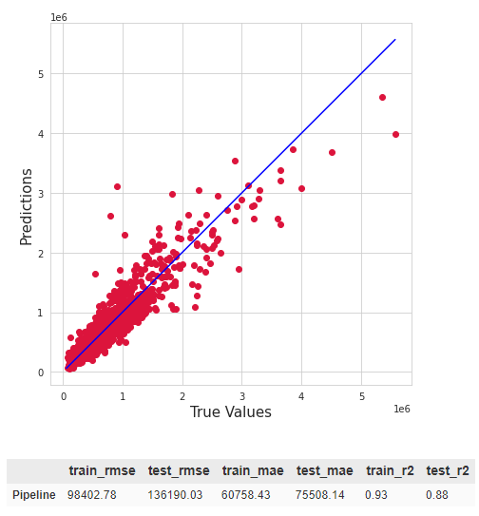
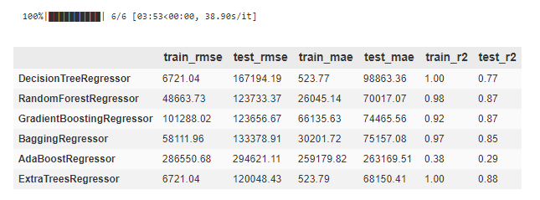
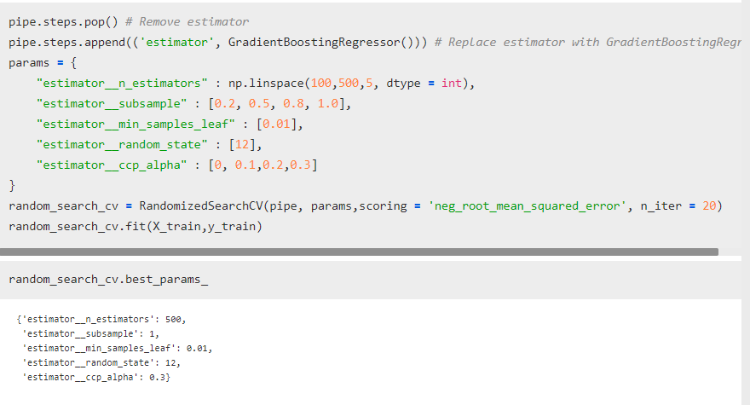
Hyperparameter Tuning & Final Model Evaluation
Model Selection w Pipeline
Hold-Out Dev Set
Hold-Out Test Set
RandomSearchCV, 20 iters
After evaluating the model with hold-out dev set, we noticed that RandomizedCV hyperparameters tuning have reduced the dev set error of a small margin at the cost of slight increase in variance of our model which can be noticed by the 2% increase of gap between train and test for the final tuned pipeline. Due to the time constraint, I did not pursue further to try reduce the high variance caused after hyperparameters tuning.(As this is an assignment with deadline)

Slide 8
CONCLUSION
By using GradientBoostingRegressor, we have managed to estimate the housing prices with its attribute down to accuracy of around 129k of Root Mean Squared Error on average by trying out various preprocessing techniques and geo-location feature engineering.

Slide 9
THANKS
Personal Learning Reflection
Through the seattle housing price prediction problem, I've learned more of Geo-location Feature Engineering without leaking the actual housing prices as well as grasp a better understanding of the Bias-Variance trade-off through countless iterations of redefining the params grid, hyperparameter tuning, model evaluation and again! Initially due to the poor design of parameter searching grid, which results in the resulting model being more overfitted than the default parameter, despite the drop in test error. By doing more research and read-up on the Gradient Boosting, I've identified several key hyperparameters that can improve the performance without increasing the variance as much. I've also decided to make use of AWS Sagemaker to host and run the entire experiment to speed up the experimenting iteration for this project.
Written By : Wong Zhao Wu
Last Modified : 26 May 2021

